Slide 2
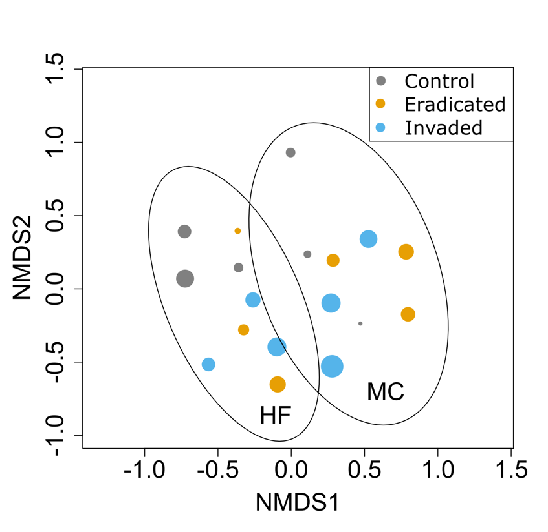

Slide 3
NMDS2

Slide 4
R^{2(invaded)}=0.75

Slide 5
Control
Eradicated
Invaded
NMDS2

